Slide 1
Emergency Room Patient Management System
Presented by:
LOKKU DAKSHITHA
KULLURU ASWINI
MUNI MOUNIKA
MALLI THEJASWINI

Slide 2
Introduction
Emergency Rooms (ERs) in hospitals must prioritize patients based on the severity of their conditions. Efficient management of patient admission and discharge is critical to saving lives. In real-world ERs, patients with more urgent medical needs are treated before those with less severe problems.
This project simulates an ER management system using Priority Queues, where patients are admitted and discharged based on their severity levels — ensuring that the most critical cases receive attention first.

Slide 3
Objective
To design and implement a patient management system where patients are prioritized based on severity.
To simulate real-world ER scenarios where patient handling must be fair, fast, and organized.
To understand and apply Priority Queue concepts using Data Structures and Algorithms (DSA).
To practice C programming for solving real-life problems involving dynamic data handling.

Slide 4
Why C and DSA?
Speed and Efficiency: C is a low-level language that allows precise control over memory and performance — critical for real-time systems like ER management.
Strong Fundamentals: C enforces strong understanding of arrays, structures, and memory management, helping develop a solid programming base.
Portability: Programs written in C can be easily ported and compiled on any system with minimal changes.
Understand the importance of Data Structures and Algorithms.
DSA forms the backbone of efficient problem-solving
Helps in selecting the right structure for the right problem.

Slide 5
Algorithm
Initialize Queue: Create an empty queue to store patients.
Admit Patient:
Input the patient's name and urgency level (1 = most urgent, 5 = least urgent).
Add the patient to the queue.
Discharge Patient:
Remove the patient with the highest urgency (smallest number).
Show Waiting Patients:
List all patients in the queue by their urgency level.
Exit: End the program.

Slide 6
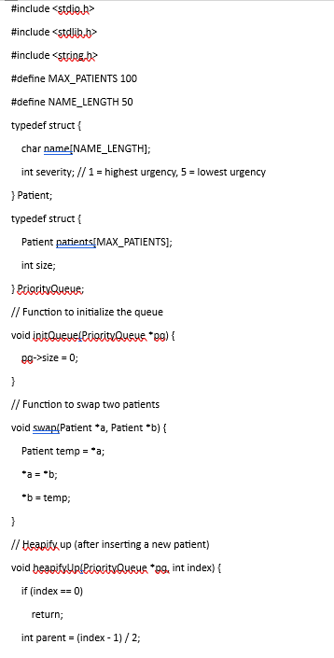
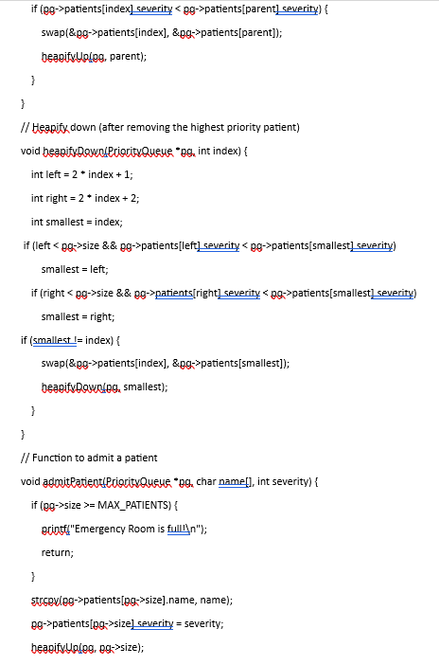
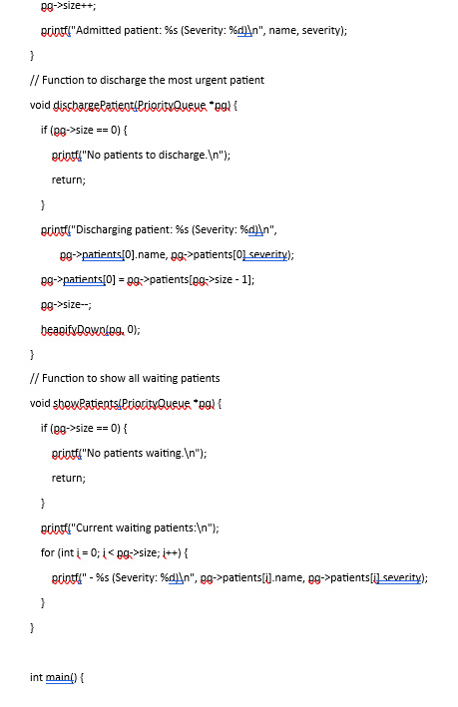
Code

Slide 7
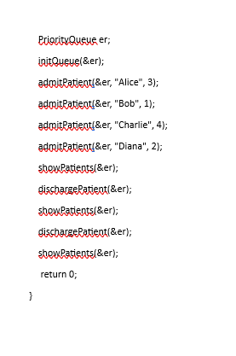

Slide 8
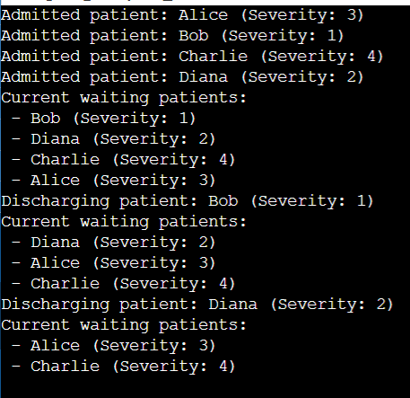
Output

Slide 9
Lesson learnt
Implementing Heaps and Priority Queues.
Mapping real-world problems to programming solutions.
Improved memory management in C.
Importance of efficient data handling in critical systems.

Slide 10
Thank You

